Slide 2
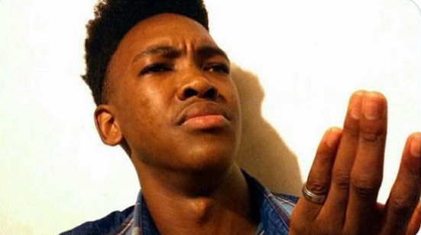
As a father raising two very active boys in America, having a communal space where others can contribute towards their development has always been a big goal. A place that they can identify with and where time moves at a different pace. Unfortunately, there are many parents that are just like my wife and me. The idea of having a homestead (Boma), that will help me not only achieve that goal for my boys but also provide a chance for the community to develop culturally, mentally, physically, and spiritually is just a but a few of the goals we have.
There are a few places in town that cater to the international community, but the demand is greater than supply. Furthermore, not many cater specifically to immigrants from Africa. In fact, there are no local options for fresh African vegetables and even fewer organizations targeting an ever-growing African Immigrant community in the St. Louis region. We at the Bomas intend to bridge that Gap.
Starting a farm and capitalizing on the growing market is, however, not the only thing we intend to do.
This will not just be your typical farm; we intend to impact the community not just in the Metro East but across the nation and globally. The Bomas of Thairu intends to provide a much-needed service to the local community, lovers of the African continent, its food culture, and People.
As a cultural institution, we aim to create a cultural marketplace that can be a refuge, a sanctuary, a place where young members of the community will have an opportunity to see what it is like to live on an African farm. We will showcase vegetables being grown right here in town and give them an opportunity to play with some goats at our petting zoo and Goat yoga studio.
There are many lovers of Africa who unfortunately cannot afford the high $$ ticket required for airfare, just to have an African Experience. There are many first-generation Americans of African origin who have never had an opportunity to travel to a homeland that should be well known. The Bomas will be that place where we can bring those dreams closer to reality.
BOX 1 Burning Platform
Available options offer singular experiences.
Most venues are rental places with restrictions.
Most local Farmers do not grow the vegetables we are used to
There is not enough organizations helping to keep up with the number of immigrants moving to the area.
Unemployment

Slide 3
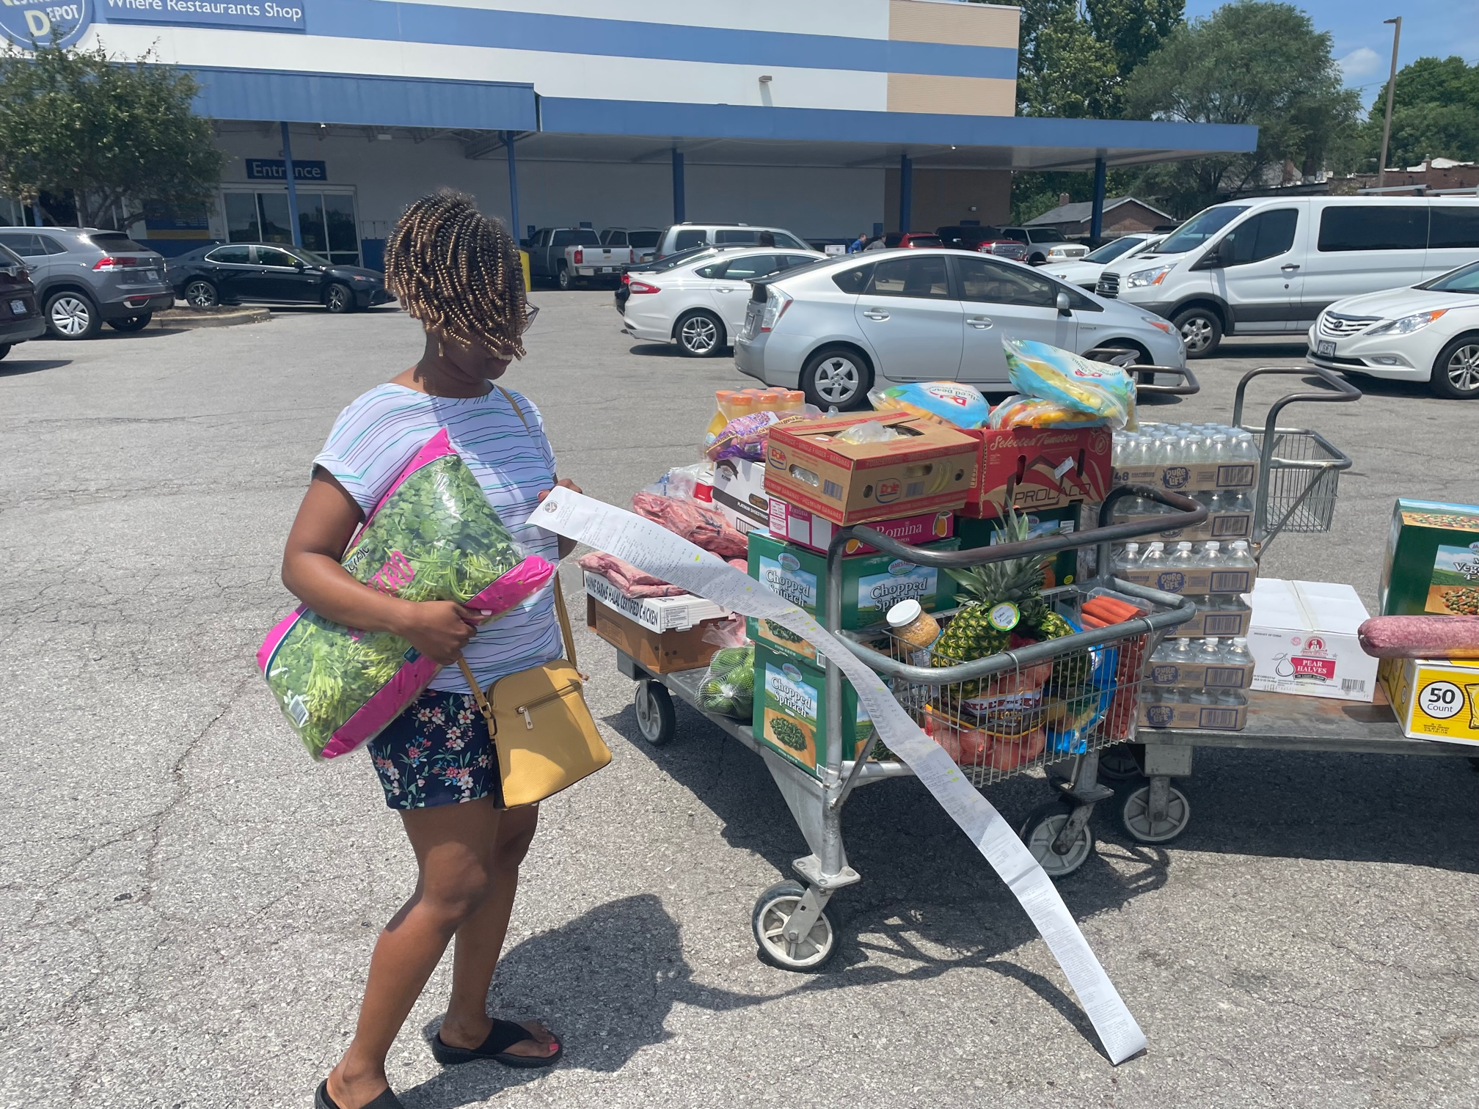
BOX 2 Current state
Nationwide, Black farmers make up 1.4% of the country’s 3.4 million producers. Its even worse locally. There were around 890 Black producers in Illinois in 1920. Illinois currently has about 70,000 farms, according to the 2019 Census of Agriculture, but Black producers own only 188.
There is only one meat processing plant that specializes in Goat meat in greater STL area that can produce at scale
The average distance travelled by an African in STL in search of Goat meat and other familiar foods is 45 Minutes.
Lack of enough institutions that cater to the holistic African experience from a human perspective.
High cost of groceries/Meat with goat meat rising to $11 per Pound in the summer of 2022.
Increased rates of suicides across the age spectrum among refugees and immigrants.
High unemployment mostly due to language barrier. (Language of commerce)
The death of many a man.
U.S. immigrants faced higher unemployment under COVID-19 but gap has closed | Pew Research Center
An Illinois bill aims to counteract a decades-long trend: The decline of the Black farmer - Investigate MidwestInvestigate Midwest
Foreign Born Workers: Labor Force Characteristics-2021 (bls.gov)
https://www.newvision.co.ug/news/1533704/suicide-cases-refugees-rise-unhcr

Slide 4
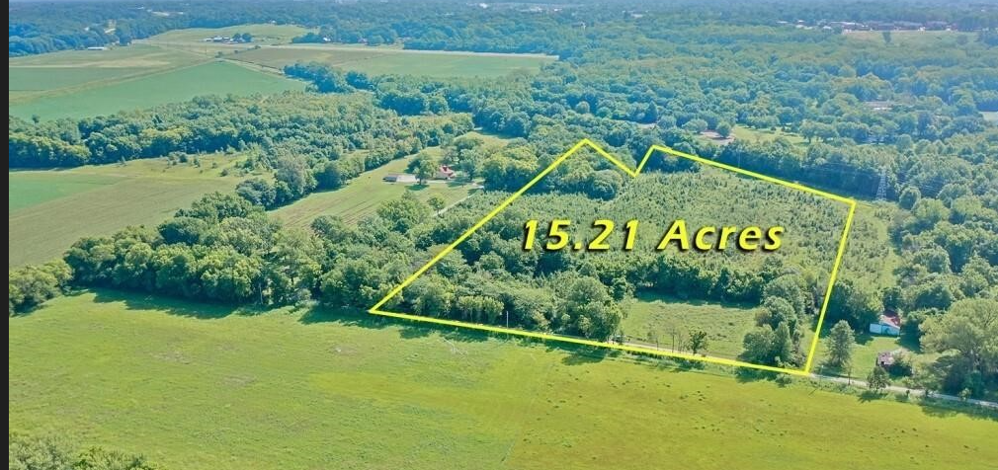
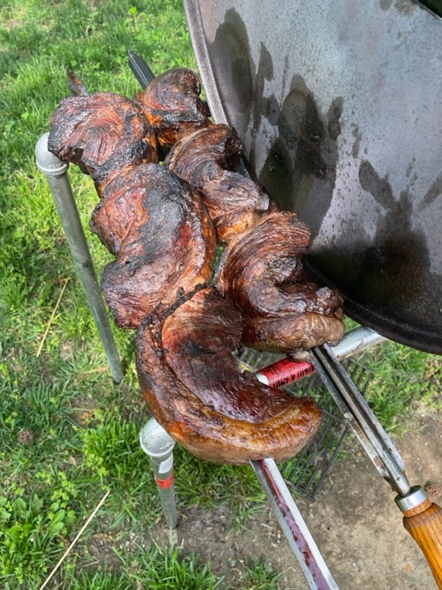
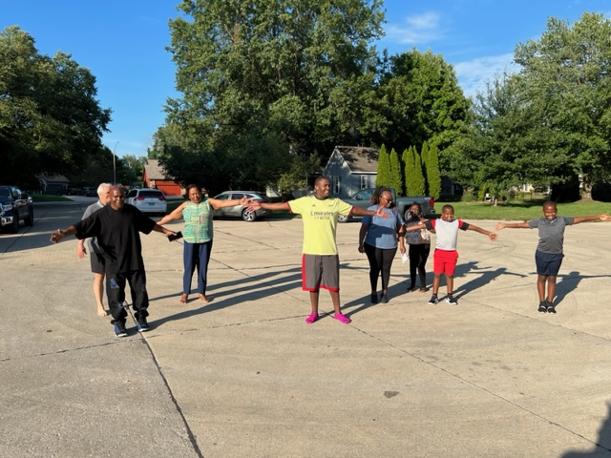
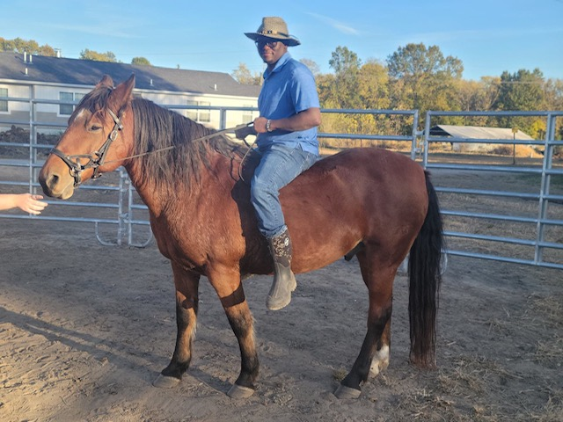
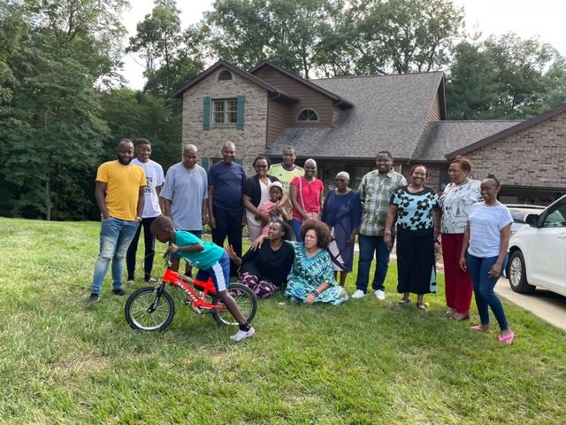
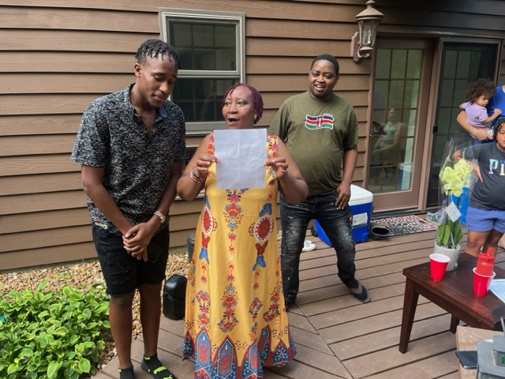
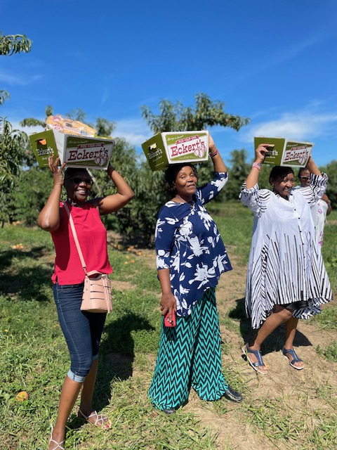
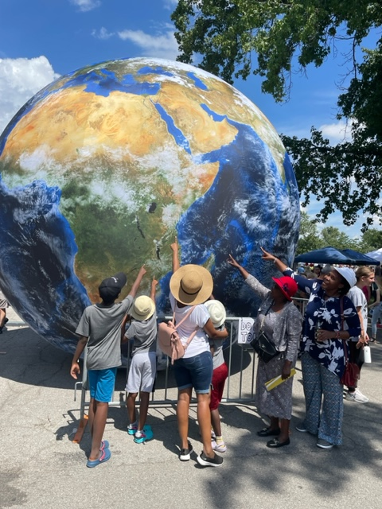
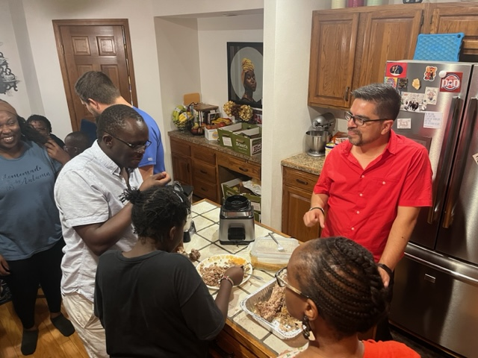
BOX 3 Future state
Add 10 new Producers (farmers) of color in the STL area by year 2025
Establish a goat meat processing plant in the metro east to extend the current supply base.
Reduce grocery community to an average of 15 minutes or less in the greater STL area
Create an African Cultural center that can offer a holistic/authentic cultural experience right here in STL.
Establish/partner with local organizations to cater for Mental health issues among the immigrants.
Bomas life skills technical school.
Teaching supply chain fundamentals to immigrants for entry level jobs in warehousing and manufacturing.
Life skills training/Welding/animal husbandry etc.

Slide 5
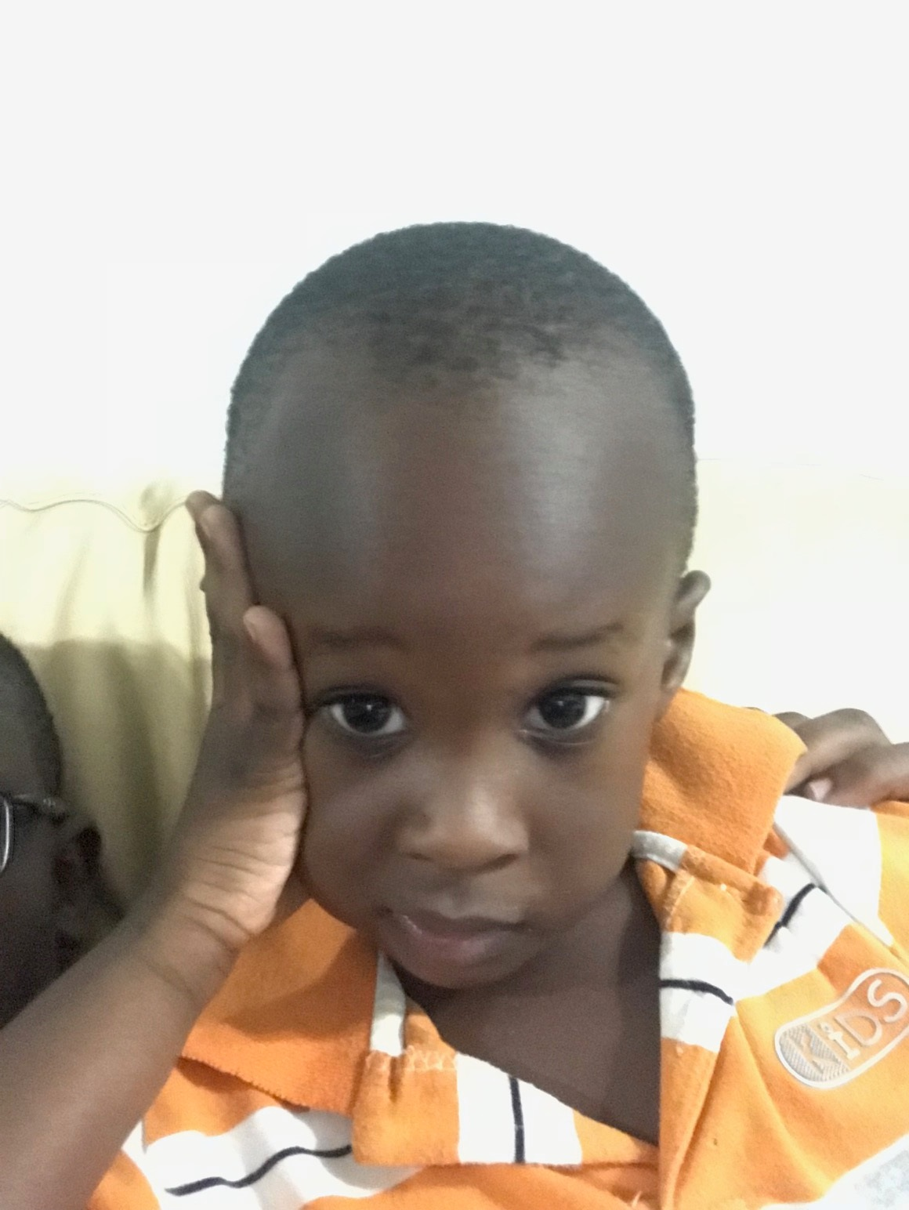
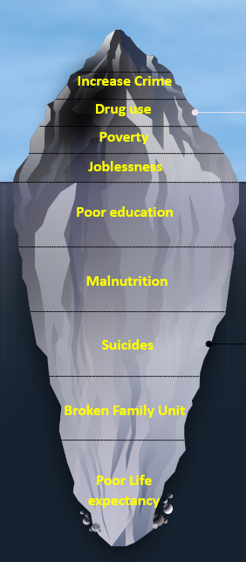
Box 4 GAP ANALYSIS
Family Unit
Mental Health
Bridge the gap by providing an avenue to address issues impacting the community.
Education
Food security
Develop a farm that caters to the needs for immigrants in the area.
Be a learning institution for both skills and culture.
Man/Woman of Character
What is a family
The Gaps Are many
Problem is bigger than it seems.
Vital Few

Slide 6
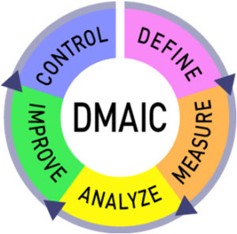
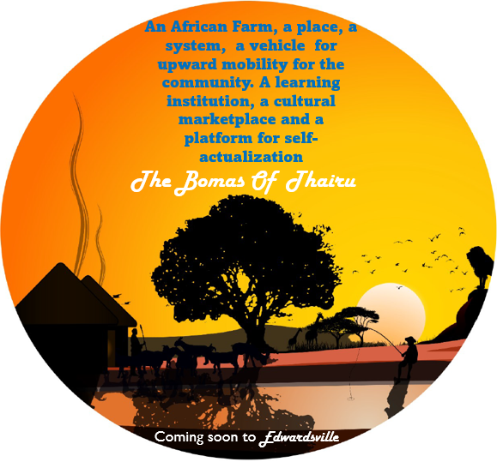
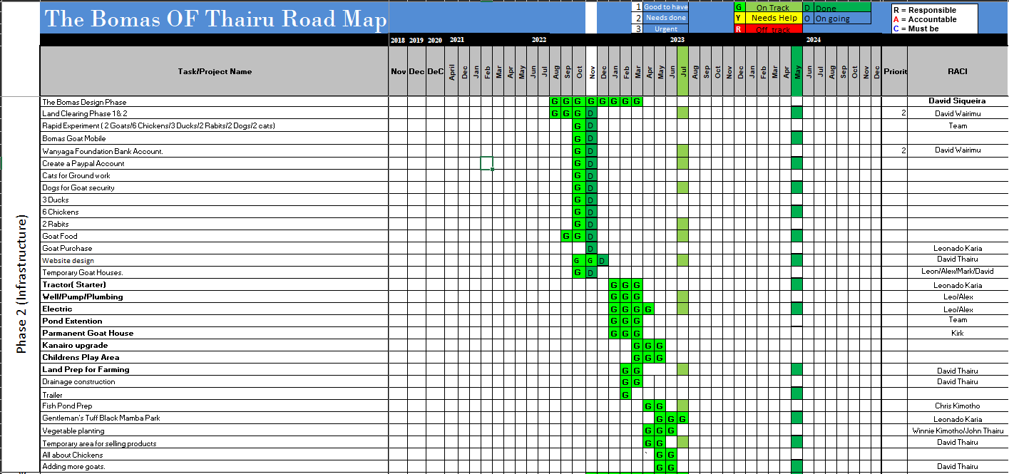
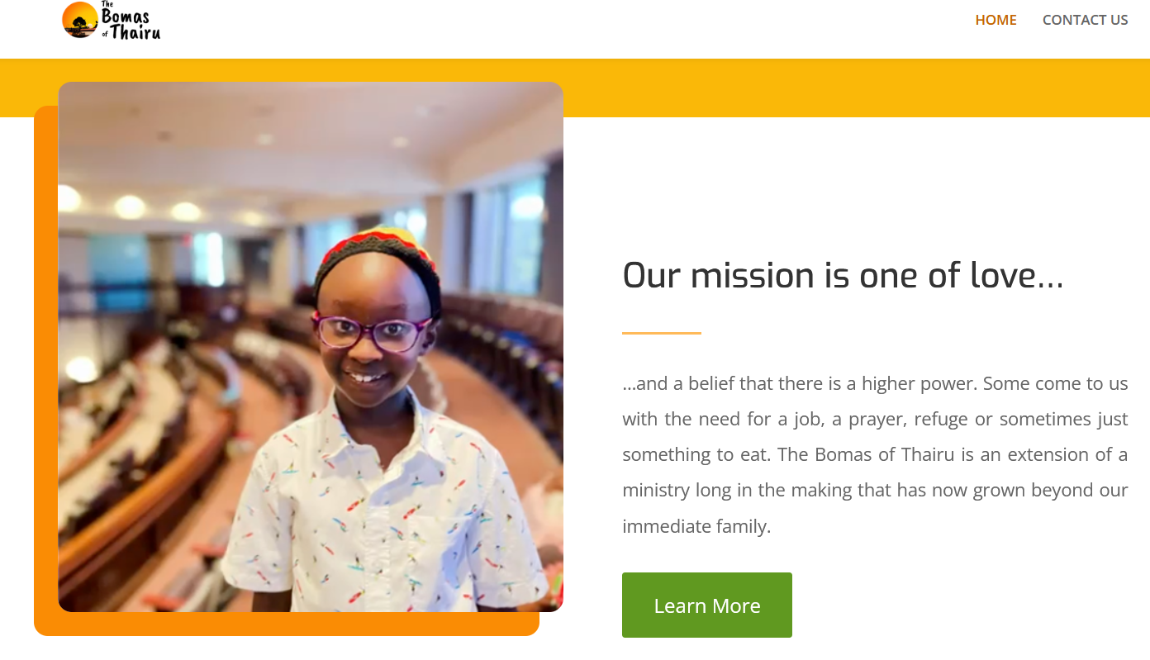
Box 5. Solution Approach.
A Farm like no Other
The Bomas Of Thairu:
Build something, Be something

Slide 7
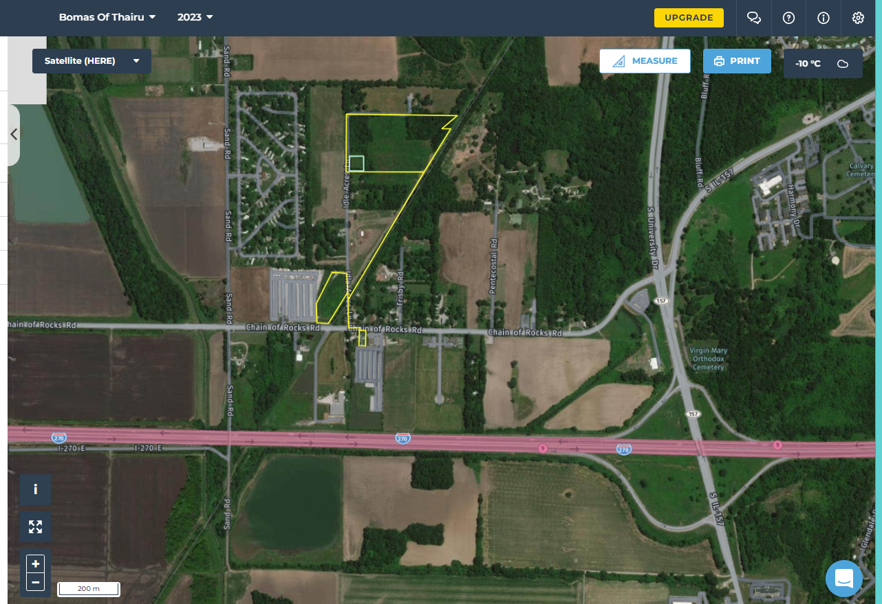
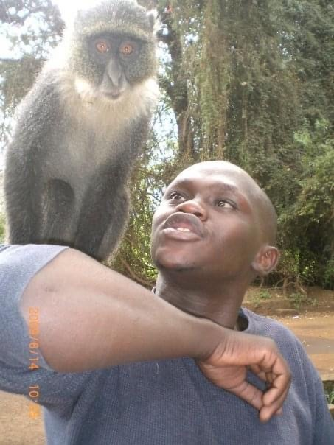
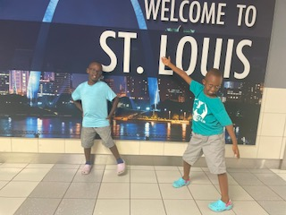
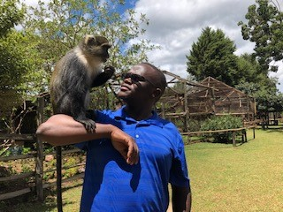
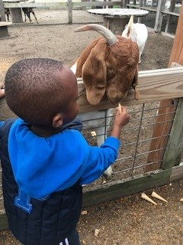
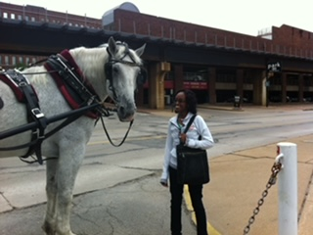
Solution Approach:.
Once an animal lover always animal lover
Desire to raise Our Children in an environment that reflects where we grew up (Values and Culture and environment)
What type of America will they come back and grow up in? (Who gets to teach them about where they are from?)
Project House
The Farm
Road side market
You can take a Maasai from Kenya, but you can’t take the Maasai out of Him

Slide 8
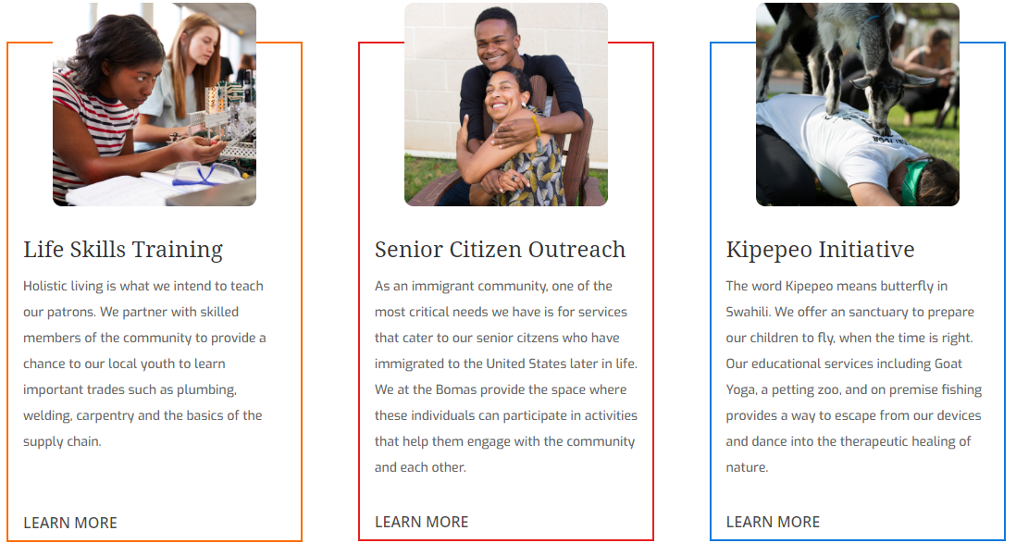
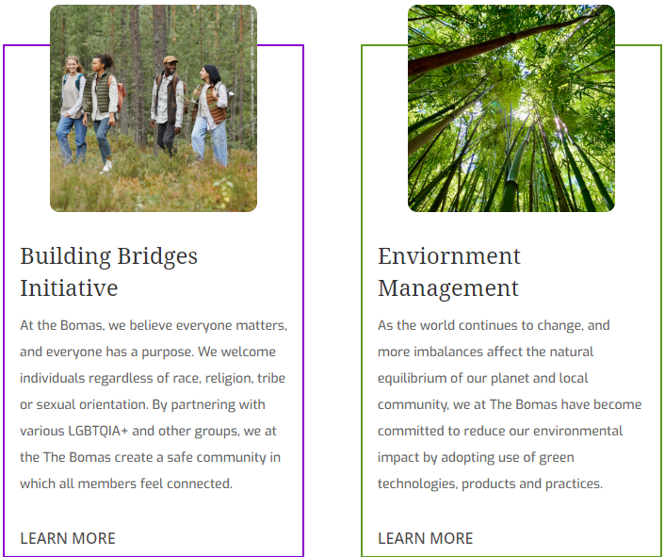
Solution Approach.
How we intend to serve the community

Slide 9
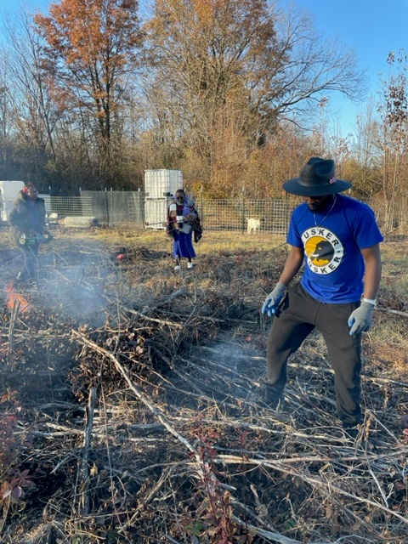
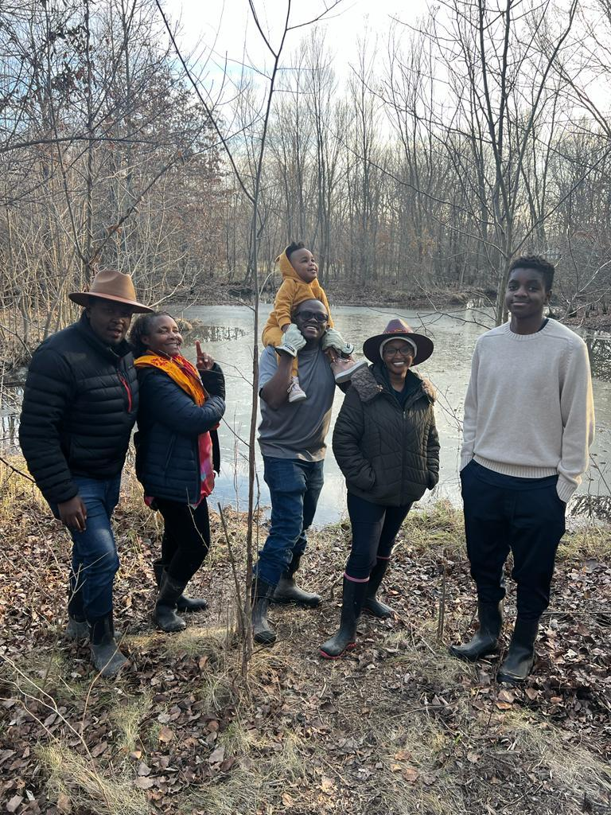
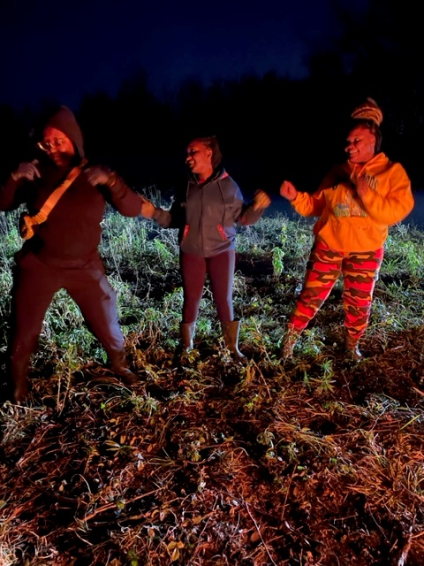
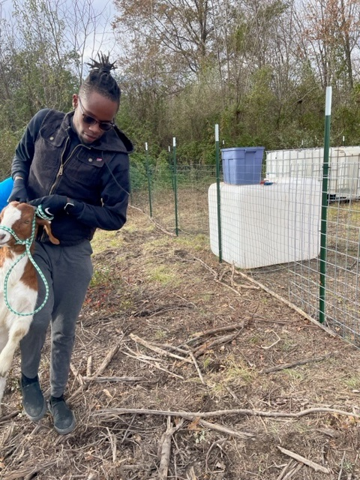
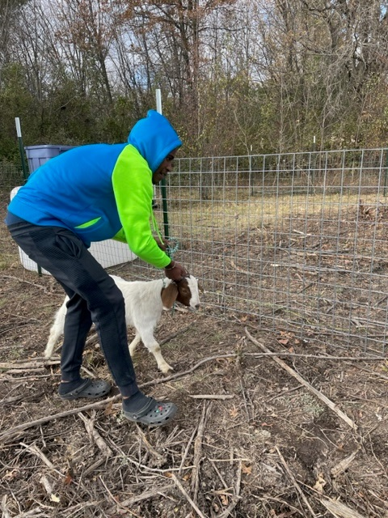
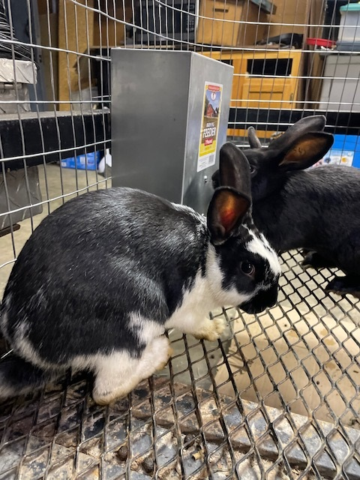
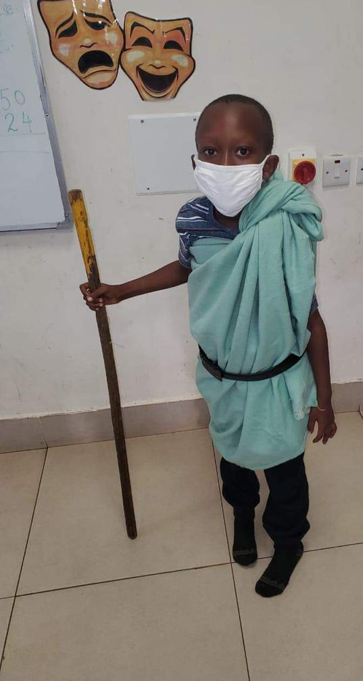
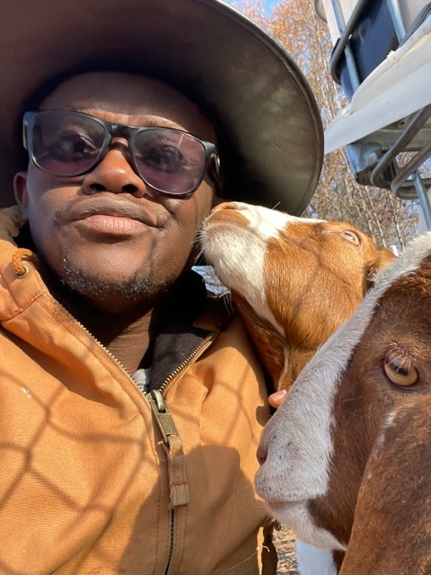
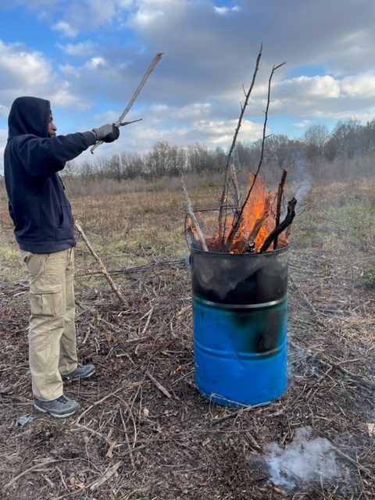
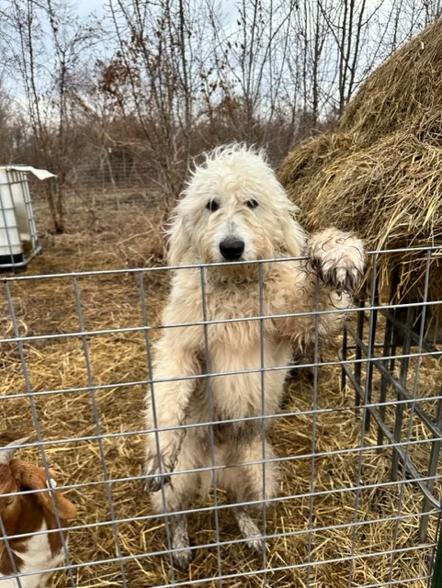
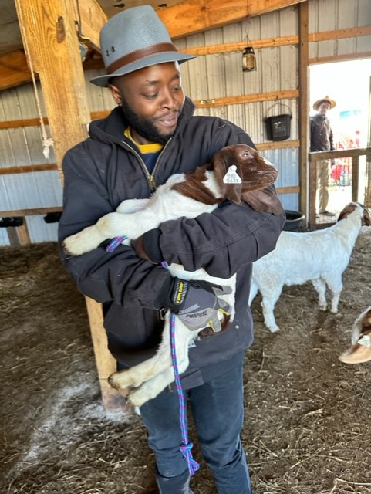
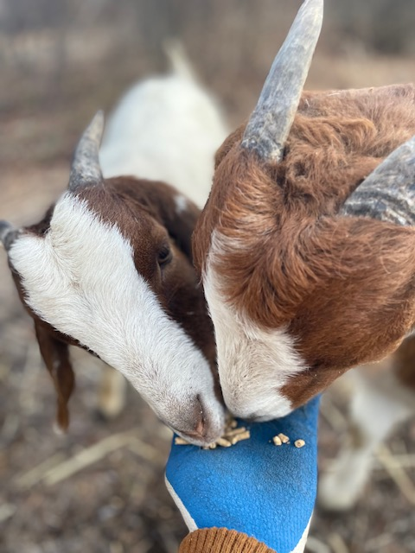
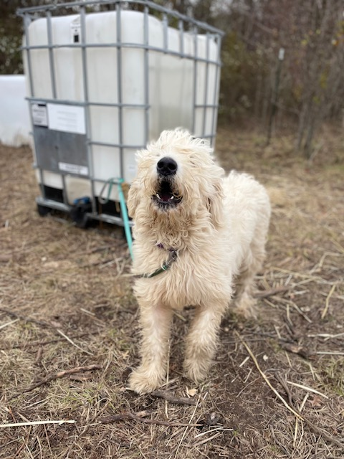
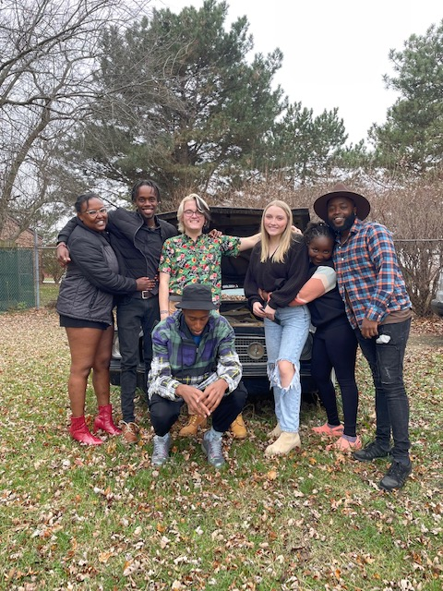
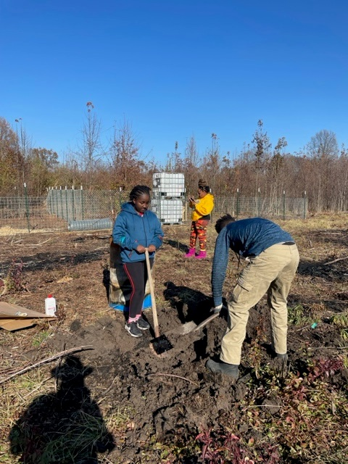
Box 6. Rapid Experiment

Slide 10
Coming up next
Time for ACTION ( Time For Africa)
½ an Acre stocked pond- Mar/2023
Fire side Chat- African Stories by the fire- May/2023
Goat Yoga- May 2023
One of a Kind African Jungle Gym/Mountain Bike Trail – Jul 2023
African Watering hole (Fresh and cold drinks on the MCT bike Trail) Jul 2023
Oti’s Grill –One of a kind farm to table dining experience Sep/2023.

